Slide 1
Lecture 6
Risk Management
CSCI – 3350 Software Engineering II
Fall 2014
Bill Pine

Slide 2
Lecture Overview
Sources of risk in software development
Consequences of unmanaged risk
Risk mitigation / Risk management
Barry Boehm Top 10 Risk List

Slide 3
Introduction
By taking steps to manage risk, we acknowledge:
  Software development is inherently risky, and
  Therefore prone to failure
All the efforts expended in project management are of little value if
  Project development time is lengthening, uncontrollably, in response to unmanaged risk
The purpose of risk management
  Keep the project risks firmly in view
  Address those risks

Slide 4
Introduction (continued)
What constitutes a risk?
  Anything that adversely affects the three goals of a successful project
The project manager must therefore take steps to mitigate risks
  The first step is to identify the risks

Slide 5
Sources of Risk
Sources of risk can be divided into two categories:
  Technical factors
  Human factors

Slide 6
Technical Risk
Technical risks take many forms and depend on the specific details of the project
Some examples of important categories of technical risks
  Project complexity
  Project size
  Project innovation
  Security
  Information attainability – how quickly can you get it
  Production quality data may not be available for testing
  High quality graphics

Slide 7
Project Complexity
There are problems in computer science that are intractable
  Intractable ≡ the time for solution increases exponentially (or faster) with increased problem size
    The traveling salesman problem
    The knapsack problem
    The best next move in a game of strategy
      Chess, Checkers, Othello

Slide 8
Project Complexity (continued)
If our problem is intractable
  Must rely on heuristics to find near optimal solutions
The Risk?
  Formulating an effective heuristic approach to finding a “good” solution in a reasonable amount of time, i.e. next move in chess

Slide 9
Project Size
When beginning a very large project,
  Project is not understood in sufficient detail
  Unanticipated stumbling blocks are numerous
  May need to add a large number of tasks,
    As project becomes better understood
  Implications – failed project
    Project late
    Project over budget
    Project quality poor
    Or (more likely) a combination of the above

Slide 10
Project Innovation
Some projects need state-of-the-art technology
  Development team will experience risk in the form of significant delay in
    Learning the new technology
    Adapting the way the team functions
    Converting existing code to the new technology
    Dealing with a potentially “buggy” technology
  There is a potential upside
    The expenditure of effort in learning the new technology may pay big dividends on future projects
    But in the words of Jimmy Driftwood
      “That ain’t a-doin us no good now” Soldier’s Joy

Slide 11
Security
To mention but a few
  Network vulnerability
    Must build in safeguards to prevent “thugs” from
      Viewing data
      Destroying or modifying data or programs
  Disgruntled employees
    Similar damage as above, carried out by “insiders”
      Either development team members or client employees
      Involved end-users
      Time bombs
  White collar crime
    Money handling systems need a system of checks and balances to prevent theft of money or information

Slide 12
Information Attainability
The domain experts (remember these guys?) may see the new system as a threat to their livelihood
  Refuse to co-operate
  Provide incomplete information
  Provide misleading information
  Result:
    System is built upon incomplete or erroneous domain knowledge

Slide 13
Production Quality Data Not Available
Client cannot or will not provide “real” data
  Can’t interrupt current operations
  Highly sensitive data
Any data that is generated to simulate the “real” data, may not accurately reflect the “real” data
  Too small
  Missing key stressors

Slide 14
High Quality Graphics
Many systems require high quality artwork to be effective
The risk:
  The artwork produced may be of a low enough quality to compromise the system effectiveness

Slide 15
Sources of Human Factors Risk
The sources of risk from people involvement can be assigned to 3 categories
  Client / Users
  Management
  Developers
Humans are very difficult to predict / categorize
In spite of an aggressive Risk Management Program, people will occasionally do something that is:
  So erratic and unpredictable that no reasonable risk manager could have anticipated it

Slide 16
End-User Risks
End-users add risk to a project in a number of ways
  End-users may feel that the new software system will put their jobs at risk
    May withhold information about their job procedures from the analysts
    May give incorrect or misleading information about their job procedures
  End-user may not be very technology aware
    Don’t know what to ask for in terms of capabilities
    Developers tend to give the users that for which they asked
    End users don’t get the maximum functionality from the system
    This is a large risk, and one that must be clearly addressed in any system

Slide 17
End-User Risks (continued)
  There may be a wide range of technology savvy among the end-users
    The resulting conflict in system envisioned by the various users makes the job of the analyst difficult
    The analyst must resolve the different visions, but since he is not a part of the client organization this can be very hard to do
  The end-user may be reluctant to adopt the new system (or any new system)
    This is an inertia issue
    This attitude was institutionalized in the Loudon County, VA motto - “We bide our time”
      The motto perfectly represented the underlying attitude of county government employees toward change in any form

Slide 18
Management Risks
Management control introduces the following risks
  Budgetary constraints
  Project priority shifts
  Unrealistic expectations

Slide 19
Budgetary Constraint
If management is inexperienced in software development, they may
  Impose arbitrary time and cost constraints on the project
    Without reducing the scope of the project
    Thereby unintentionally sabotaging the project
  If management has a history of doing this
    Software project managers compensate in a variety of ways
      Over-estimate the time and cost of project
      Withhold information from management

Slide 20
Project Priority Shifts
For no good (translate → technical) reason,
  Management support for the project can shift
    Corporate earnings
    Shareholder pressure
    Internal politics
    A whim

Slide 21
Unrealistic Expectations
Not understanding the need for the early phases of software development
  Requirements elicitation, analysis, preliminary design, ...
    Feel that this is a “good place to cut the fat”
    Allocate unrealistic time and cost constraints to the “unproductive stuff”

Slide 22
Developer Risks
An unfortunate fact:
  “Members of the development team are human”
This “humanness” leads to the following risks that can be categorized into several areas
  Individual productivity is extremely variable
  Individual experience is also quite variable
  Individual knowledge is also variable
  Individual motivation is perhaps the most variable of all
  Individual random influences are unknowable

Slide 23
Individual Productivity
From one individual to another
For a given individual
  From one day to the next
  From one season to the next
Difficult to estimate task completion time
  Especially when using an individual for the first time
  Even when you have worked with the individual before

Slide 24
Individual Experience
All members on the team bring with them a different set of experiences
This can be a strength by providing a broad base of real world experiences
Can be a weakness, if you assume some minimal level of experience
  “Everyone knows the Fruggle-hopf methodology”

Slide 25
Individual Knowledge
The issue of knowledge is somewhat easier to assess
Even that assessment won’t be perfect
Again a variety of experience on the team can be either a strength or weakness

Slide 26
Individual Motivation
Strongly affects productivity
Everyone is motivated by something
  But may not be to turn out a great product
  Some motivators
    Money
    Recognition
    Promotion / power
    To effect positive change
  A key managerial skill
    Discover what motivates an individual
    Mold that to apply to the project

Slide 27
Individual Random Influences
Any factor that can affect an individual’s availability, productivity, motivation, …
  Illness
  Family pressures
  Issues in his personal life
  Financial pressures
  Emotional issues

Slide 28
The Consequences of Risk
Since risk is defined in terms of project goals,
  It should be no surprise that consequences of unmanaged risk directly impact those goals
Or maybe complete failure if any of the above are so bad as to
  Render the project irrelevant

Slide 29
Risk Management / Risk Mitigation
An unfortunate fact:
  Most projects spend little or nothing in the way of risk mitigation or risk management
This is most regrettable since as was mentioned earlier, “Software development is an activity that is inherently risky”
This means that most projects accept unnecessarily high risk exposure
The really sad fact:
  Directing a small portion ( 5% ) of a projects resources to risk management, can have a h u g e payoff

Slide 30
Risk Management (continued)
A good organization will actively seek out ways to trade a small number of $’s for a large reduction in risk exposure
How sensitive is this relation?
  Steve McConnell provides a sketch of Probability of Meeting Schedule and Budget as a function of portion of the budget expended on risk management

Slide 31
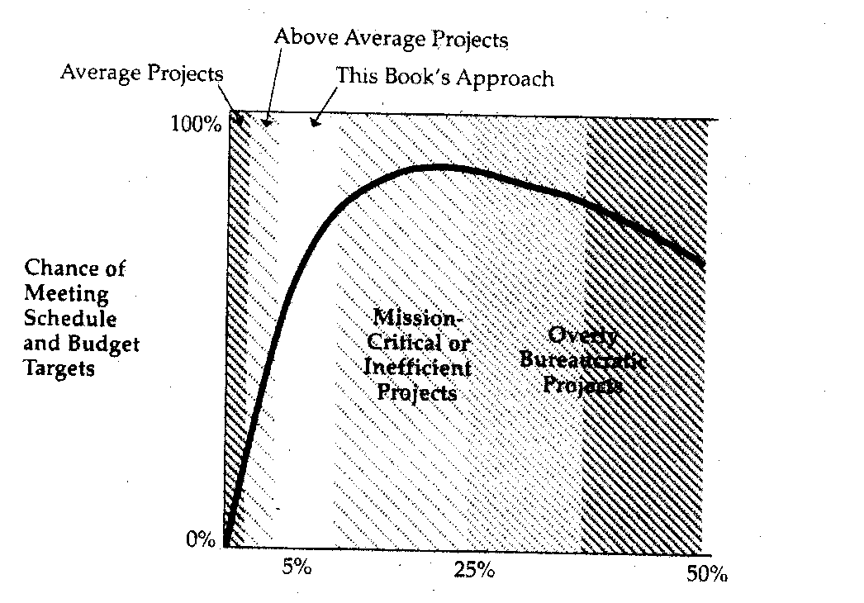
McConnell’s “Risk Curve”
Conclusion: A small amount of effort can greatly increase the probability of a successful project
Figure From Steve McConnell, “Rapid Development”

Slide 32
“Risk Curve” (continued)
McConnell estimates that the risk management technique that follows
  Will consume approximately 5% of the total development
  Will result in a probability of .5 - .7 for a successful project
Projects that need to further reduce risk, will be forced into the area of diminishing returns
It is not possible to achieve a probability approaching 1 for any project of significance

Slide 33
“Risk Curve” (continued)
To achieve the desired risk reduction, corporate management must commit to risk management
Aside: Does the previous graph remind you of one from economics?
  Art Laffer and the Laffer Curve

Slide 34
Management Commitment
Management commitment to risk management includes three elements
  The project plan includes a well defined risk management plan, in writing
  The project budget must include $’s set aside to execute the risk management plan
  When risks are assessed, their impact must be included in the project plan (budget and schedule)
If these elements are not present, there is no management commitment

Slide 35
Levels of Risk Management
Pressman’s 5 levels
  Crisis management
    Brush fire fighting - Address risks only after they have become major problems
  Fix on failure
    Detect and react to risk quickly
  Risk mitigation
    Plan to address risks after they occur
  Prevention
    Plan to identify risks and prevent them from becoming problems
  Elimination of root causes
    Identify and eliminate the root causes of risk

Slide 36
Elements of Risk Management

Slide 37
Elements of Risk Assessment
Risk Identification
  Produce a list of risks that have the potential to affect project schedule
Risk Analysis
  Determine the likelihood and impact of each risk
Risk Prioritization
  Arrange the list under a defined priority system

Slide 38
Elements of Risk Control
Risk management planning
  Create a plan for handling each risk
Risk resolution
  Execute the plan
Risk monitoring
  Observe progress toward risk resolution
  Identify “new” risks

Slide 39
McConnell Risk Plan
Create a project management position
  Risk Officer
Create, maintain and monitor
  Top Ten Project Risks list
Create a risk plan for each of Top Ten Risks
Provide a means for the team member to anonymously report risks
5% funding of this plan will result in a probability of successful project 0.5 – 0.7

Slide 40
Risk Management Officer
The risk officer’s responsibility is to identify emerging risks, throughout the project
A senior developer or tester, who is not assigned to the project in another role, is a good candidate

Slide 41
Risk Mngmnt. Officer (continued)
The Project Manager should not try to assume the role of Risk Officer
  The Project Manager focuses upon bringing the project to a successful conclusion
  It is asking too much of a Project Manager to try to identify risks that will make his job harder
    Analogous to the role of software implementer and software tester

Slide 42
Top Ten Risk List
This is the risk management tool
Create early in the project,
  Prior to or during requirements elicitation
Must be reviewed on a frequent periodic basis
  No less frequently than every two weeks
  Update the list with additional risks
  Adjust the priority
  Update the progress on the previously identified risks

Slide 43
Top Ten Risk List (continued)
Should be available to anyone working on the project, and to upper-level corporate management
All team members should be encouraged to contribute risks to the list

Slide 44
Sample Format - Top Ten Risk List

Slide 45
Individual Risk Plan
Each item on the Top 10 Risks list must have a written risk plan
  Not an elaborate document ~ 1 page
Should answer the following questions
  Why is this issue a risk?
    Describe the risk’s probability of occurrence, severity and consequences
  How will the risk be resolved?
    Describe the general approach to resolving the risk
    List or describe all options that were considered

Slide 46
Individual Risk Plan (continued)
  What specific steps will be taken to resolve the risk?
    List the steps and deliverables that will be generated in resolving the risk
    Describe the conditions under which the risks will be upgraded - calendar date, or other trigger
  Who is responsible?
    Indicate who is responsible for each step in the risk resolution

Slide 47
Individual Risk Plan (continued)
  When will each step be completed?
    Provide a date when the step will be completed
  How much of the budget is allocated to the resolution?
    List the cost of each step in the risk resolution

Slide 48
Anonymous Risk Reporting
Provide a means for team members to anonymously report risks
  Suggestion box (low tech)
  Web site (higher tech)

Slide 49
Addition Human Factors Issue
The Project Manager is held accountable for
  Meeting the delivery date
  Staying within budget
  Delivering a quality product
Often a large loss to a company is the mass departure of good technical people during or after the end of a project
This represents a loss of skills, experience, and corporate memory
Should not this be loss be also charged to the Project Manager?

Slide 50
Staffing Considerations
Ideally, how should a project be staffed?
  Hire senior technical people during the requirements elicitation phase
    You need experienced people to
      “Ferret out” the requirements
      Provide insight into the overall project vision
      Provide guidelines for the project scope

Slide 51
Staffing (continued)
Hire additional staff during preliminary design and detailed design phase
  Would like to have 2-3 man teams
  Hiring additional people doesn’t increase project productivity
  Can lead to excessive “wrangling” about minor issues
Major staffing occurs during late detailed design and implementation phases
  You can profitably make use of more people, as the tasks become better defined
  Try not to add people very late in the implementation phase can actually dilute productivity

Slide 52
Staffing (continued)
For small projects
  The flat model, with a level staffing works fine
Whatever you do,
  Hire the best people available, even if you have to wait for them to become available
  Statistics indicate that the ratio of productivity for the best developers to the worst developers is 10:1
  You can afford to wait for a 10; you don’t need a 1

Slide 53
Staffing (continued)
  Poor developers can have a negative effect on productivity
    Number of defects introduced
    Lowers team morale
    In especially egregious cases, represent a net drain on the effort and not a net contribution

Slide 54
Managing the Team
The above having been said, research by Lakhanpal, indicates that
  The team’s cohesion is the single most important factor in determining team productivity
  Individual developers capabilities run a close second to cohesion
This is important because
  Most hiring decisions are based solely on technical skills considerations
  You should give equal importance to how well an individual will mesh with the rest of the team

Slide 55
Managing the Team (continued)
  More important in staffing further on in the project, when the teams have coalesced
  A great manager will keep a smoothly working team together at the completion of the current project
Corollary:
  An individual disruptive to the team must not be tolerated
The single biggest complaint against management
  Failure to remove individuals who were not contributing to the team
  The technical people could identify the trouble makers, but management was too slow to act

Slide 56
Barry Boehm’s Top Ten List
A list compiled over a history of more than 40 projects
Risk 1: Personnel shortfalls
  Not enough people available with the needed skills
Appropriate Risk Mitigation Techniques
  Staffing with top quality people
  Job matching
  Team building
  Key personnel agreements
  Cross training

Slide 57
Boehm’s Top Ten (continued)
Risk 2: Unrealistic schedules or budgets
  Either intentional or unintentional
Appropriate Risk Mitigation Techniques
  Detailed multi-source cost and schedule estimates
  Design to cost
  Incremental development
  Software reuse
  Requirements scrubbing

Slide 58
Boehm’s Top Ten (continued)
Risk 3: Developing wrong functionality
  Getting the requirements wrong
  Not adhering to the requirements
Appropriate Risk Mitigation Techniques
  Customer mission analysis
  User survey
  User participation
  Prototyping
  Early user manuals
  Quality factor analysis

Slide 59
Boehm’s Top Ten (continued)
Risk 4: Developing wrong user interface
  Not correctly identifying the users skill level
  A wide variety of user skill levels
Appropriate Risk Mitigation Techniques
  Prototyping
  Scenarios
  Task analysis
  User participation

Slide 60
Boehm’s Top Ten (continued)
Risk 5: Gold Plating
  Adding nonessential features
Appropriate Risk Mitigation Techniques
  Requirements scrubbing
  Prototyping
  Cost-benefit analysis
  Designing to cost

Slide 61
Boehm’s Top Ten (continued)
Risk 6: Requirements Changes
  Failing to accommodate change
  Failing to limit change
Appropriate Risk Mitigation Techniques
  Set high threshold for change acceptance
  Incremental development (defer change to next version)

Slide 62
Boehm’s Top Ten (continued)
Risk 7: Shortfalls in external tasks
  Poor subcontractor performance
Appropriate Risk Mitigation Techniques
  Reference checking
  Pre-award audit
  Competitive design award

Slide 63
Boehm’s Top Ten (continued)
Risk 8: Shortfalls in external components
  Inaccurate or misleading descriptions
Appropriate Risk Mitigation Techniques
  Benchmarking
  Inspection
  Reference checking

Slide 64
Boehm’s Top Ten (continued)
Risk 9: Real-time performance shortfalls
  Not meeting the non-functional performance requirement
Appropriate Risk Mitigation Techniques
  Simulation
  Benchmarking
  Modeling
  Prototyping
  Instrumentation

Slide 65
Boehm’s Top Ten (continued)
Risk 10: Pushing the edge on technology
  Using the latest technology to its maximum capabilities
Appropriate Risk Mitigation Techniques
  Technical analysis
  Cost-benefit analysis
  Prototyping
  Reference checking

